Slide 1

Online Hotel-booking system
By Erik-Andre

Slide 2
Problem statement: - Software should allow users to book available hotel-rooms online.
Requirements:
Users should be able to browse available rooms.
Users have to add method of payment to book a room.
Users should be able to search by date or amount of beds.
Hotels should be able to offer available rooms
Hotels should be able to remove rooms that’s been booked.

Slide 3
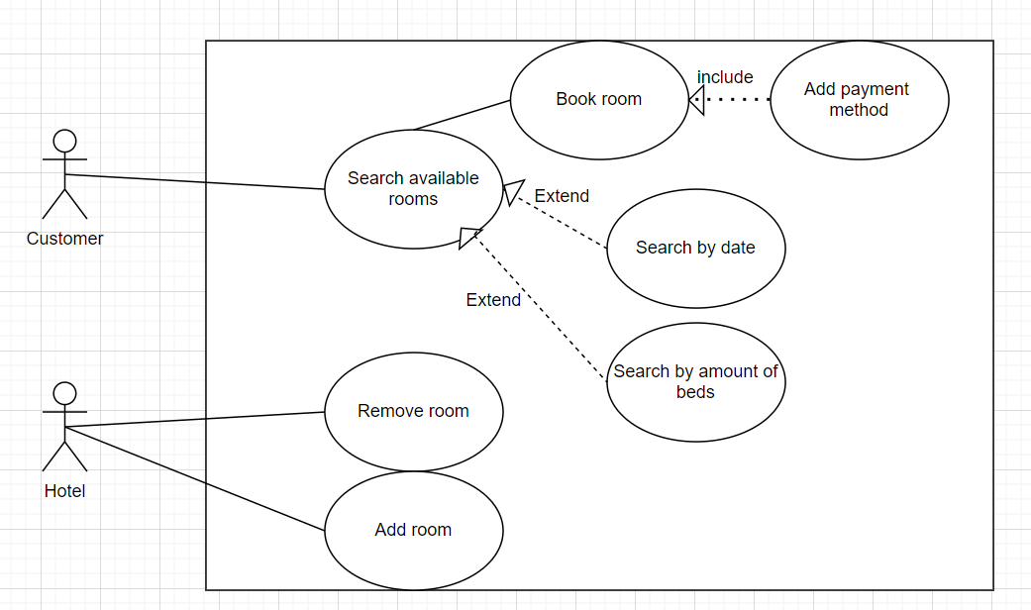
Online hotel-booking system

Slide 4
